Slide 1

RPG Tutorial Creation
by Pau Garcia

Slide 2
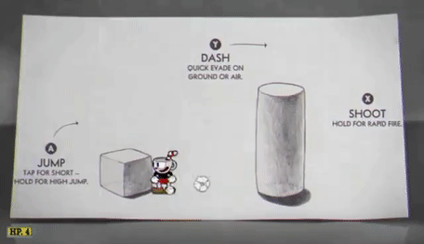
What to note about Tutorials
First Impression of the Game
Teaches the player how to play
Players won’t understand anything without it
They aren’t just “a level”
Different genres need different tutorials

Slide 3

How to Create a Good Tutorial?

Slide 4


Less Text
TEXT KILLS:
Pacing
Immersion
Wall of Text = Overwhelming
Skipped by Most Players
Tutorials Should be INTERACTIVE

Slide 5
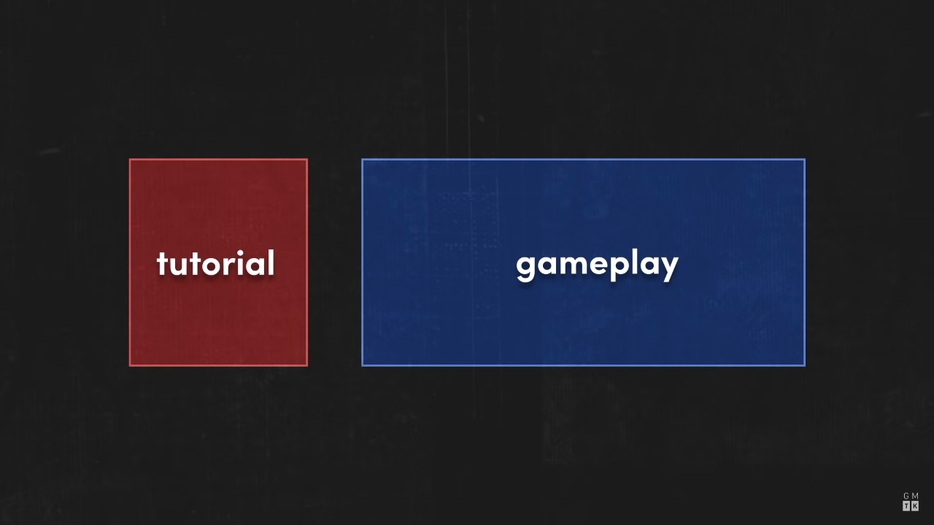
2. No Frontloading - The “Don’t”s
Don’t overwhelm the player with info
Players will:
Forget
Get Bored
Get Frustrated
Learn before they’re invested
Irrelevant info presented very early on
You get to play very late
If someone skips your tutorial, you’ve failed as a designer

Slide 6
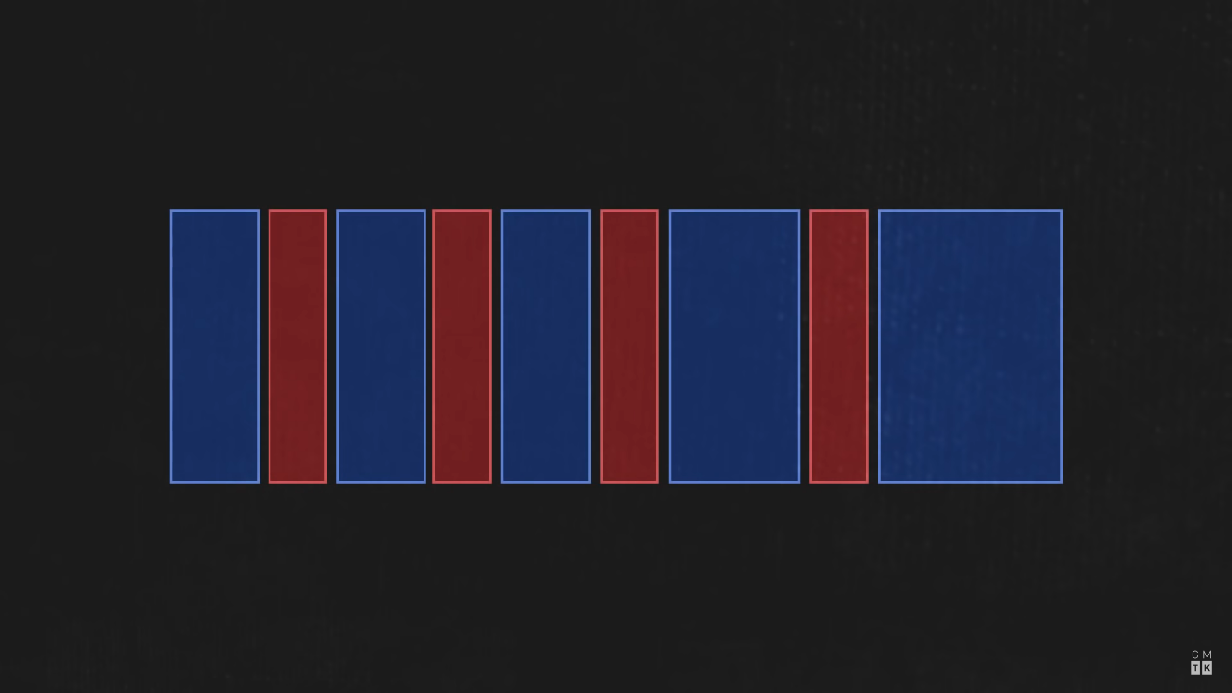
2. No Frontloading - The “Do”s
PRESENT INFORMATION WHEN RELEVANT
Allows players to test new mechanics
Players will remember more easily
Can introduce new mechanics
at the same time as the narrative

Slide 7
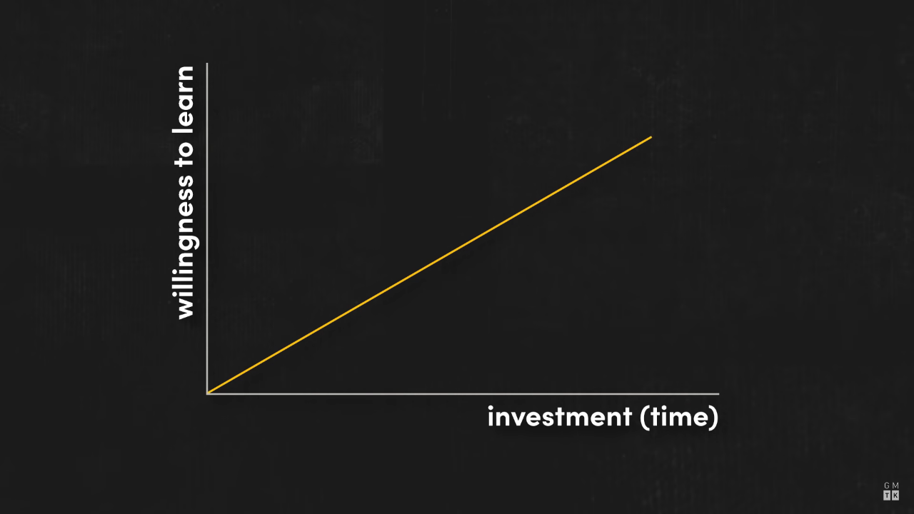
2. No Frontloading - The Learning Curve

Slide 8
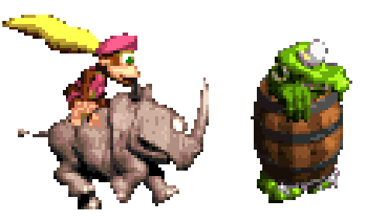
3. Make it Fun
Tutorials should be an extension of gameplay
Boring Intro Tutorial = Part of Audience Lost
The player should be learning AND playing
If you can make the player learn without noticing, you’re the GOAT

Slide 9

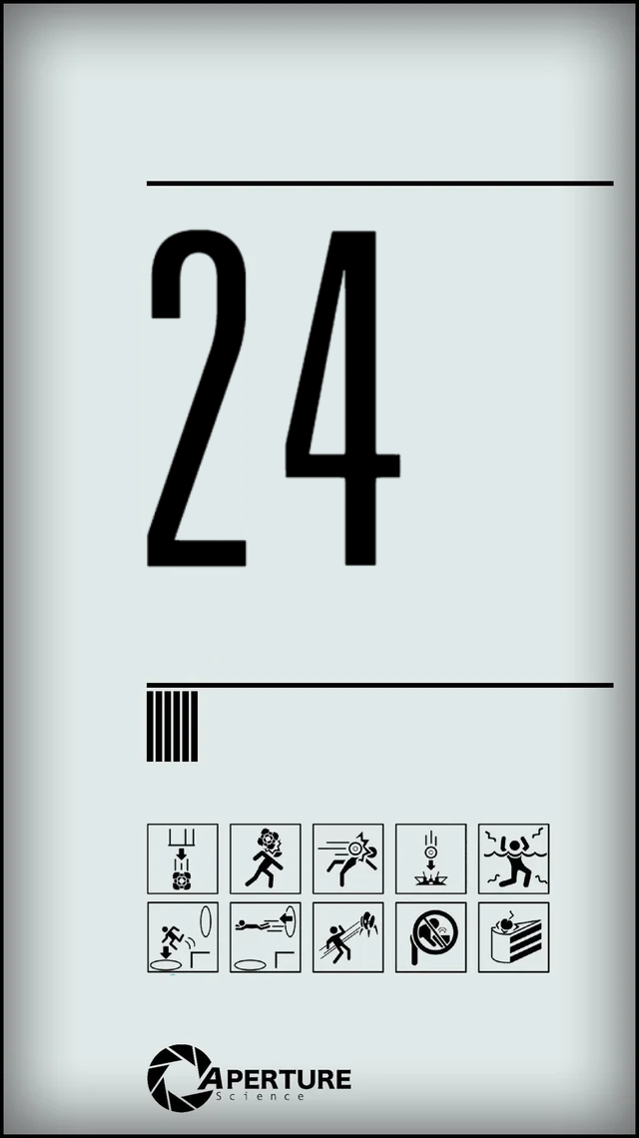
.
75% of Portal 1’s levels are a tutorial

Slide 10
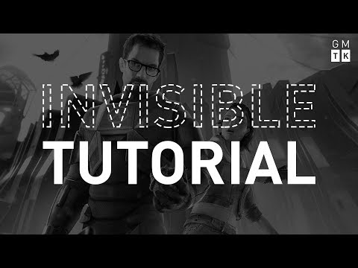
4. Reinforce Learning Through Play
If possible, the game design should teach the player by itself.

Slide 11
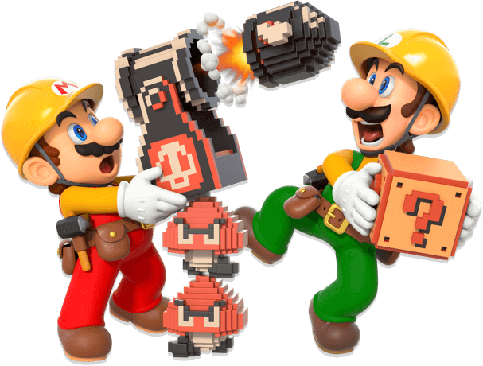
5. Playtest a Lot
Decisions obvious to us, aren’t like that for everyone
By playtesting you’ll see:
what needs to be changed
what needs to be explained
how the player plays
Don’t talk to your players; just observe and listen
Know your demographic
Eg. Depending on who you’re after, WASD means nothing

Slide 12

6. Don’t Create a Nuisance
If you’re creating a “classic” tutorial, make it skippable
Tutorials shouldn’t interrupt the flow of gameplay
Especially true for games with high replay value

Slide 13
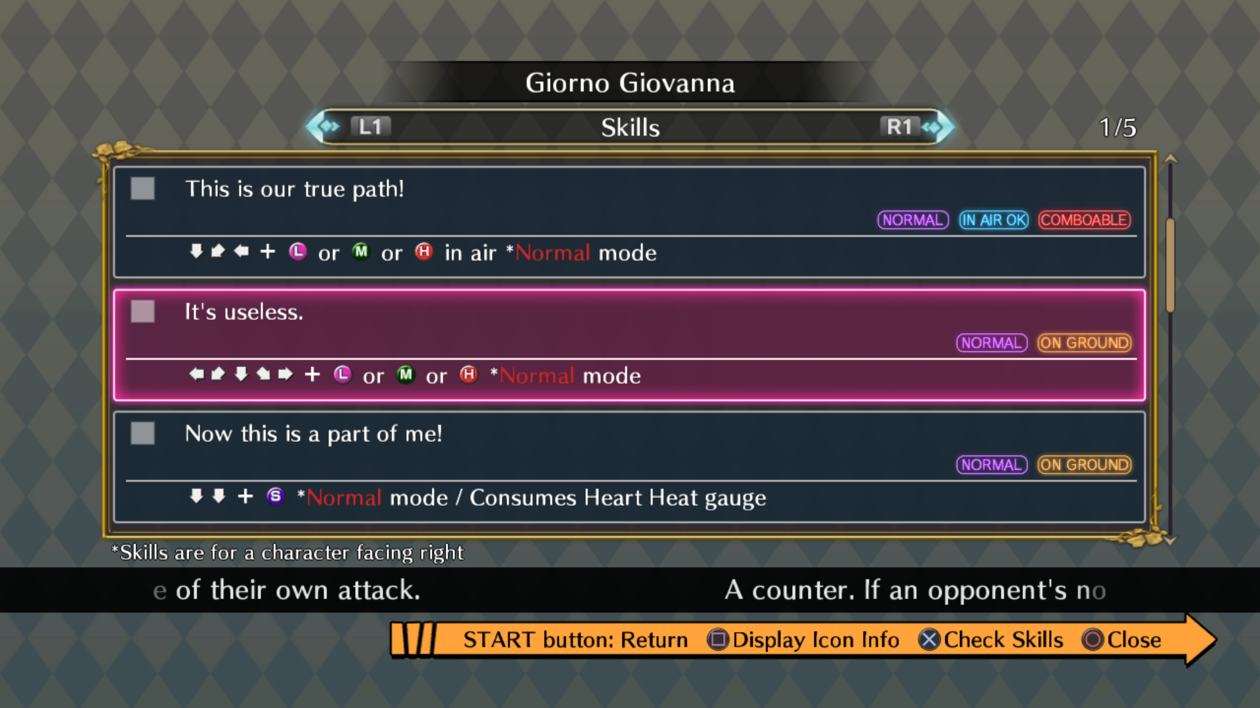
7. Accessible at all Times
Let the player revisit old information
Mechanic Encyclopedia on Options Menu
Links to “How To” videos on Options Menu
Allow player to replay Tutorial
Especially true for mechanically complex games

Slide 14
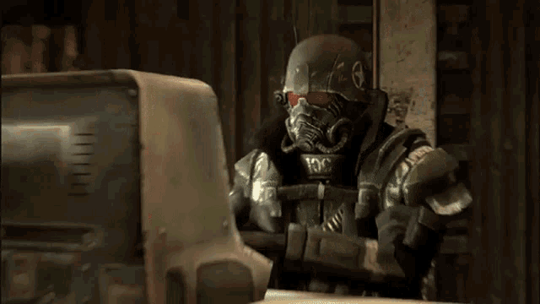
8. Don’t Leave it for the End
Implement tutorial throughout the development
You have to think about how you’re going to teach new mechanics to the player as you’re creating them
If you leave it for the last minute:
Inconsistent Tutorial
Disconnect between tutorial and narrative/gameplay
Harder to implement, will clutter development at the last minute

Slide 15

Thanks For Your Attention!

